Slide 1

Research Methods in Software Engineering
An Introduction into Philosophy of Science
for Software Engineers
Based in parts on material from a joint work with:
Antonio Vetrò (Nexa Center for Internet and Society, Politecnico di Torino)
Andreas Jedlitschka (Fraunhofer Institute for Experimental Software Engineering)
Natalia Juristo (Politecnic University of Madrid)
Daniel Méndez
www.mendezfe.org
@mendezfe

Slide 2








You can
copy, share and change,
film and photograph,
blog, live-blog and tweet
this presentation given that you attribute
it to its author and respect the rights and
licenses of its parts.
Based on slides by @SMEasterbrook and @ethanwhite

Slide 3

Ground rule
Whenever you have questions / remarks,
share them with the whole group.
don’t ask , but

Slide 4


Goal of the (invited) lectures
What you have learnt so far
Methods for empirical software engineering
Theory building
Get a “bigger picture” by better understanding
Fundamental principles, concepts, and terms in philosophy of science
The (historical) context of research strategies
Broader perspective on empirical Software Engineering

Slide 5
Exemplary, more philosophical questions
What is truth? Is there such a thing as universal/absolute truth? (i.e. assuming that there is a physical reality which represents “truth”, are we able to completely capture it via theories?)
How can we achieve scientific progress?
Which research methods should we apply?
What is a suitable (empirical) basis?
When is an observation objective? Is there really objectivity?
How much relevance/impact can we achieve? What does relevance mean?
What trade-offs do I need to make when designing a study?
…

Slide 6

Outline
Science (in a Nutshell)
Philosophy of Science - a Historical Perspective
Key Take Aways
From Philosophy of Science to Empirical Software Engineering
Empirical Software Engineering Processes
Current Challenges in Empirical Software Engineering

Slide 7
Outline
Science (in a Nutshell)
Philosophy of Science - a Historical Perspective
Key Take Aways
From Philosophy of Science to Empirical Software Engineering
Empirical Software Engineering Processes
Current Challenges in Empirical Software Engineering

Slide 8
“Science” wasn’t built in a day…
1896-1980
384-322 BC
…
1561-1626
1694-1778
1724-1804
…
1902-1994
…
Aristoteles
Bacon
Voltaire
Kant
Piaget
Popper
…
Progress of knowledge of nature (reality)
Draw benefits from growing knowledge
Era of Rationalism
Era of Constructivism
Search for laws and reasoning for phenomena
Understanding the nature of phenomena
System of Epistemology
Era of (French) Enlightenment
Emancipation from god and beliefs
Science is a human undertaking for the search of knowledge (by portraying reality and its laws)
It needs to be considered in a historical context
Knowledge growth
Increased understanding of scientific working (and what science eventually is)

Slide 9
Stress-fields in science
Ontology
Epistemology
Ethics
Questions on the “being”
Questions on knowledge and the “scientific discovery”
Questions on actions and morality
From: Orkunoglu, 2010

Slide 10
Stress-fields in science
Ontology
Epistemology
Ethics
Is there a world independent of subjectivity?
From where do discoveries result? From experiences?
From where does ethics result? Does there exist something like universal ethics?
Realism
Rationalism
Normative Ethics
Idealism
Empiricism
Descriptive Ethics
From: Orkunoglu, 2010

Slide 11
Setting
Example
Philosophy of science
Epistemology
Principle ways of working
Empiricism
Controlled Experimentation
Methods and strategies
Hypothesis testing
Fundamental theories
Statistics

Slide 12
Setting: Philosophy of science
Branch of philosophy concerned with
foundations,
methods, and
implications
of/in science(s).
Central questions:
What qualifies as scientific working?
When are scientific theories reliable?
What is the purpose of science?
Philosophy of science
Principle ways of working
Methods and strategies
Fundamental theories

Slide 13
Setting: Empirical Software Engineering
Philosophy of science
Principle ways of working
Methods and strategies
Fundamental theories

Slide 14

Setting: Empirical Software Engineering
Philosophy of science
Principle ways of working
Theory building and evaluation
… are supported by…
Methods and strategies
Methods and strategies
Analogy: Theoretical and Experimental Physics
Fundamental theories

Slide 15
Goals of the lecture
Get a basic understanding of
philosophy of science
implications for our discipline
context of research methods and strategies
Philosophy of science
Principle ways of working
Theory building and evaluation
… are supported by…
Methods and strategies
Methods and strategies
Analogy: Theoretical and Experimental Physics
Fundamental theories

Slide 16
What is Science?
What do you think?

Slide 17
What is science about?
Systematically and objectively gaining, documenting/preserving, and disseminating knowledge

Slide 18
What is science about?
Systematically and objectively gaining, documenting/preserving, and disseminating knowledge
Gaining knowledge by the systematic application of research methods
Reasoning by argument / logical inference
Empiricism (case studies, experiments,…)
…
Research should:
Have a high scientific and / or practical relevance and impact
Be rigorous and correct
However…
There is no universal way of scientific working (see Pragmatism / epist. anarchy)
Method appropriateness depends on many non-trivial factors

Slide 19
What is science about?
Systematically and objectively gaining, documenting/preserving, and disseminating knowledge
In principle, we try to be objective (independent of subjective judgment)
However…
There is nothing absolute about knowledge/“truth” (see Scientific Realism)
Accepting documented knowledge depends on acceptance by (subjective) peers, often judging by desire for “novelty”, “aesthetics”, etc. (see Post-Positivism)
Accepting scientific results is also a social process

Slide 20

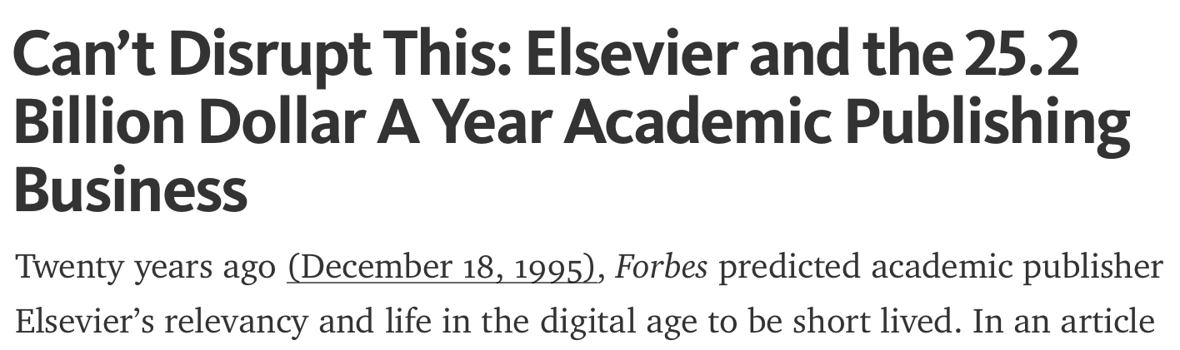
What is science about?
Systematically and objectively gaining, documenting/preserving, and disseminating knowledge
Scientific knowledge needs to be disseminated
documented in a reproducible way following (often unwritten) rules,
evaluated (by peers), and
disseminated / communicated to the public
However…
Science (and scientific publishing) is also part of an economic system
Source: https://medium.com/@jasonschmitt/can-t-disrupt-this-elsevier-and-the-25-2-billion-dollar-a-year-academic-publishing-business-aa3b9618d40a#.il1kxilt9

Slide 21

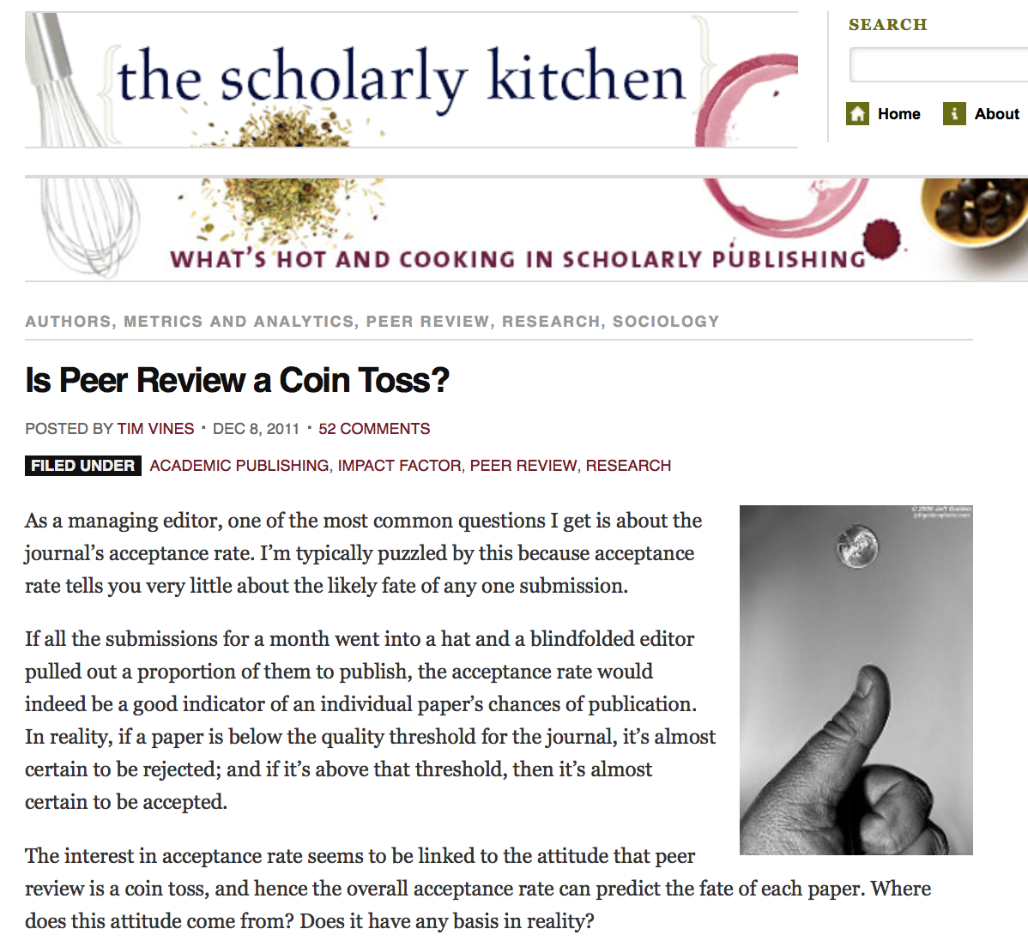

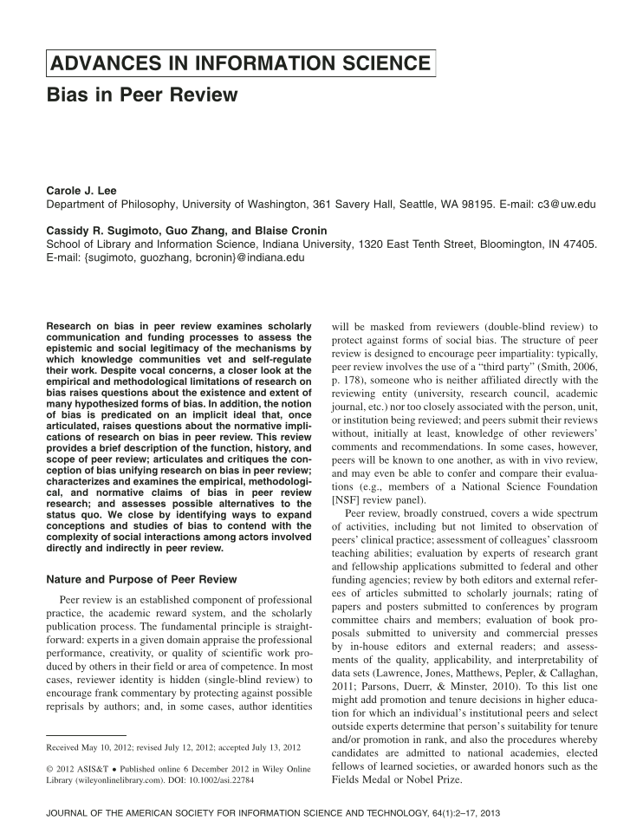
In the end, science is a human undertaking
Source (l): https://scholarlykitchen.sspnet.org/2011/12/08/is-peer-review-a-coin-toss/
Source (r): http://onlinelibrary.wiley.com/doi/10.1002/asi.22784/abstract

Slide 22
Scientific knowledge
Necessary postulates for scientific working
There are certain rules and principles for scientific working
There is a scientific community to judge about the quality of scientific work
There is a reality that exists independently of individuals’ observations — the physical truth (“realism”) — and individuals can make observations about (an excerpt of) reality
Although observations may be faulty, it is possible (on the long run) to make reliable observations and to falsify incorrect statements about reality
Scientific knowledge is a portrait we paint of (our understanding of) reality.

Slide 23
Is Software Engineering research science?
What do you think?

Slide 24
Science can have different purposes
Basic Science
Design Science
Gaining and validating new insights
Often theoretical character
Typically addressed by natural and social sciences
Guiding the application of scientific methods to practical ends
Often rather practical (and pragmatic) character
Typically addressed by engineering disciplines
In software engineering (research),
we apply scientific methods to practical ends (treating design science problems)
we also treat insight-oriented questions, thus, we are an insight-oriented science, too.

Slide 25

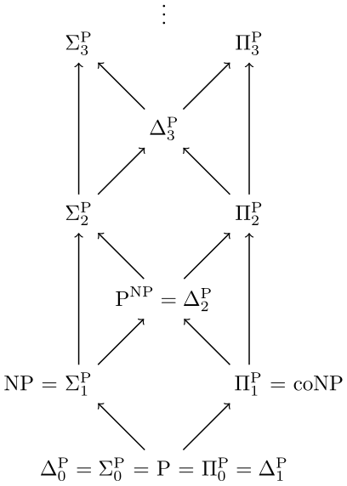

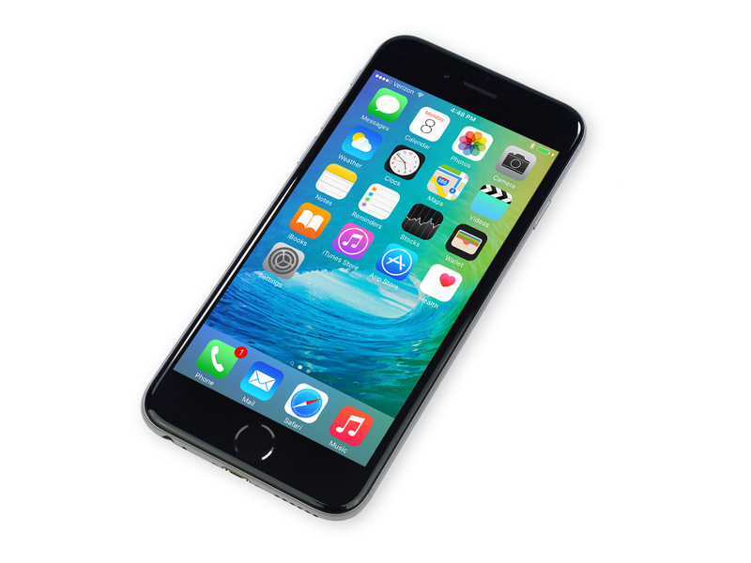
Science can have different purposes
Basic Science
Design Science
* Polynomial time hierarchy (structural complexity theory)
Fundamental
Research
Applied Research
Image Sources (left to right): Wikipedia, nasa.gov, Apple

Slide 26
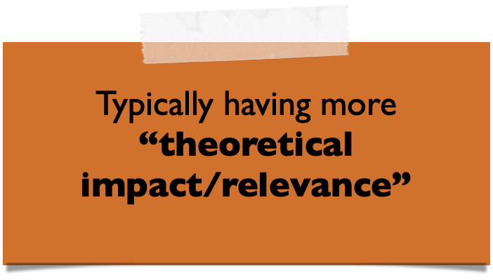
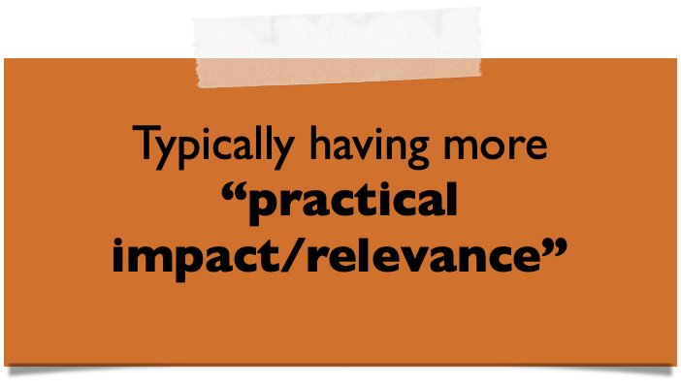
Science can have different purposes
Basic Science
Design Science
Fundamental
Research
Applied Research

Slide 27
Is Software Engineering research science?
Yes.

Slide 28
Outline
Science (in a Nutshell)
Philosophy of Science - a Historical Perspective
Key Take Aways
From Philosophy of Science to Empirical Software Engineering
Empirical Software Engineering Processes
Current Challenges in Empirical Software Engineering

Slide 29
What are Theories?
(A quick prologue)

Slide 30
Theories (generally speaking)
A theory is a belief that there is a pattern in phenomena.
Examples:
Global warming was invented by the Chinese government to harm the US industry
Vaccinations lead to autism
Are these theories scientific?
Speculations based on imagination or opinions that cannot be refuted
Further examples: https://twitter.com/realdonaldtrump

Slide 31
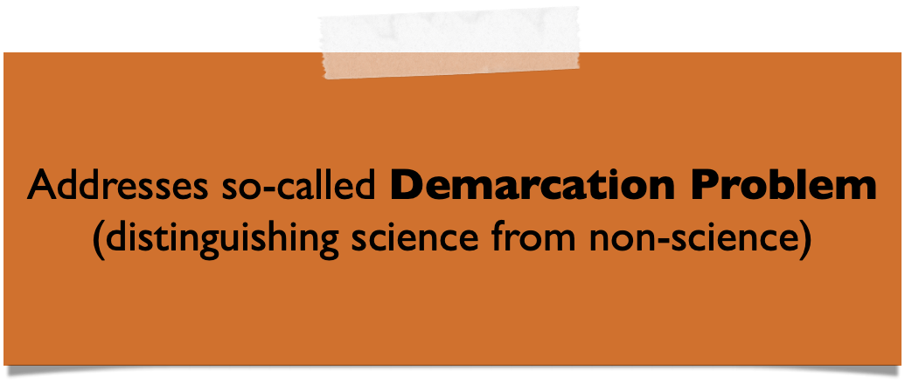
Scientific theories
A scientific theory is a belief that there is a pattern in phenomena while having survived
tests against experiences
criticism by critical peers
1. Tests
Possibly experiment, simulation, trials
Replication
2. Criticism
Anonymous peer review / acceptance in the community
Corroboration / extensions with further theories

Slide 32
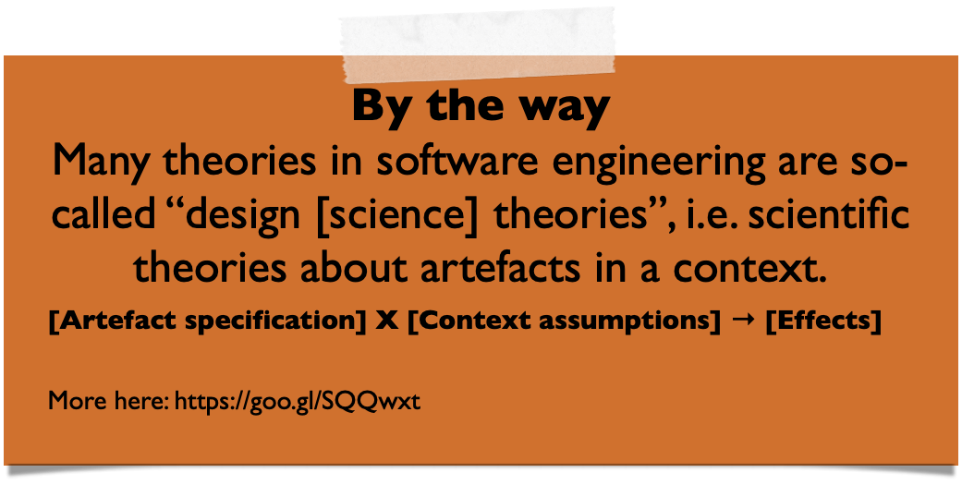
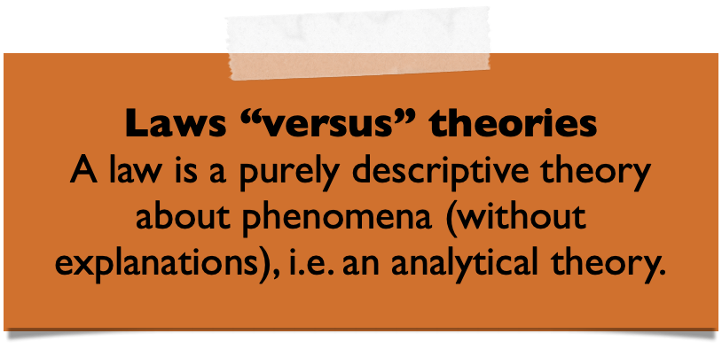
Scientific theories have…
A purpose
Quality criteria
Testability
Empirical support / (high) level of evidence
Explanatory power
Usefulness to researchers and / or practitioners
…
 | Analytical | Explanatory | Predictive | Explanatory & Predictive
Scope | Descriptions and con-ceptualisations, including taxonomies, classifications, and ontologies - What is? | Identification of phenomena by identifying causes, mechanisms or reasons - Why is? | Prediction of what will happen in the future - What will happen? | Prediction of what will happen in the future and explanation - What will happen and why?
Based on: Sjøberg, D., Dybå, T., Anda, B., Hannay, J. Building Theories in Software Engineering, 2010.

Slide 33
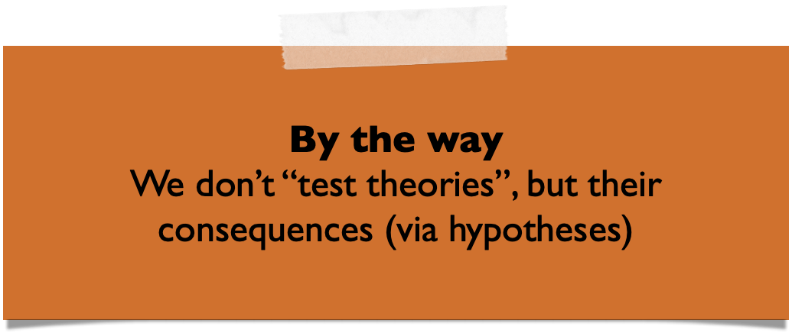
Theories and hypotheses
Theory / Theories
Scientific theory
“[…] based on hypotheses tested and verified multiple times by detached researchers” (J. Bortz and N. Döring, 2003)
Theory (Pattern) Building
Hypothesis Building
(Tentative) Hypothesis
Hypothesis
“[…] a statement that proposes a possible explanation to some phenomenon or event” (L. Given, 2008)
Grounded in theory, testable and falsifiable
Often quantified and written as a conditional statement
Falsification / Corroboration
Empiricism
If cause/assumption (independent variables)
then (=>)
consequence (dependent variables)

Slide 34
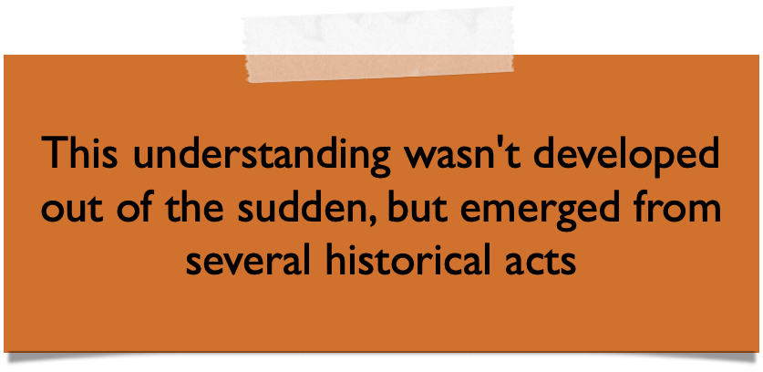




From real world to theories… and back
Principles, concepts, terms
Theory / Theories
Abduction
(Creative) Synthesis of an explanatory case from a general rule and a particular result (observation)
Theory (Pattern) Building
Hypothesis Building
Induction
Deduction
Inference of a general rule from a particular case/result (observation)
(Tentative) Hypothesis
Application of a general rule to a particular case, inferring a specific result
Falsification / Corroboration
Empiricism
Units of Analysis
Sampling Frame (Population)
Sampling
Real World

Slide 35
An Introduction into the
(History of) Philosophy of Science…
… in several Acts

Slide 36
Act 1
Era of Positivism

Slide 37
Gaining knowledge through sensory experiences
Image Source: Antoine de Saint-Exupéry. Le Petit Prince, 1943.

Slide 38
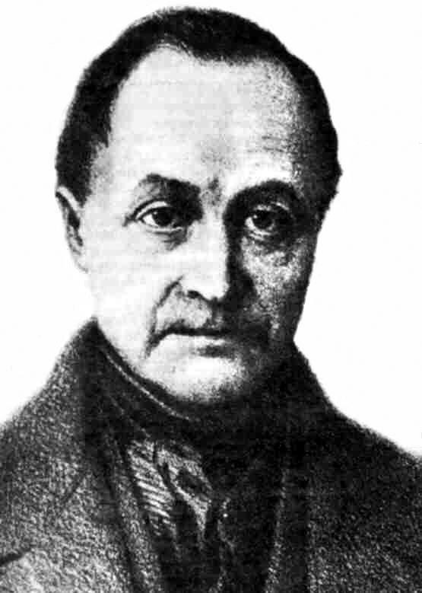
Origin and principles
Positivism traced back to Auguste Comte (1798–1857). (A. A General View of Positivism, 1848 (French), 1865 (English).)
Emerges from a secular-scientific ideology in response to European secularisation (Enlightenment - Voltaire)
Knowledge (i.e. theories)
Must not be governed by its association with divine presences
Derived from sensory experiences (based on empirical evidence)
Interpreted through reason and logic
Only source of truth

Slide 39
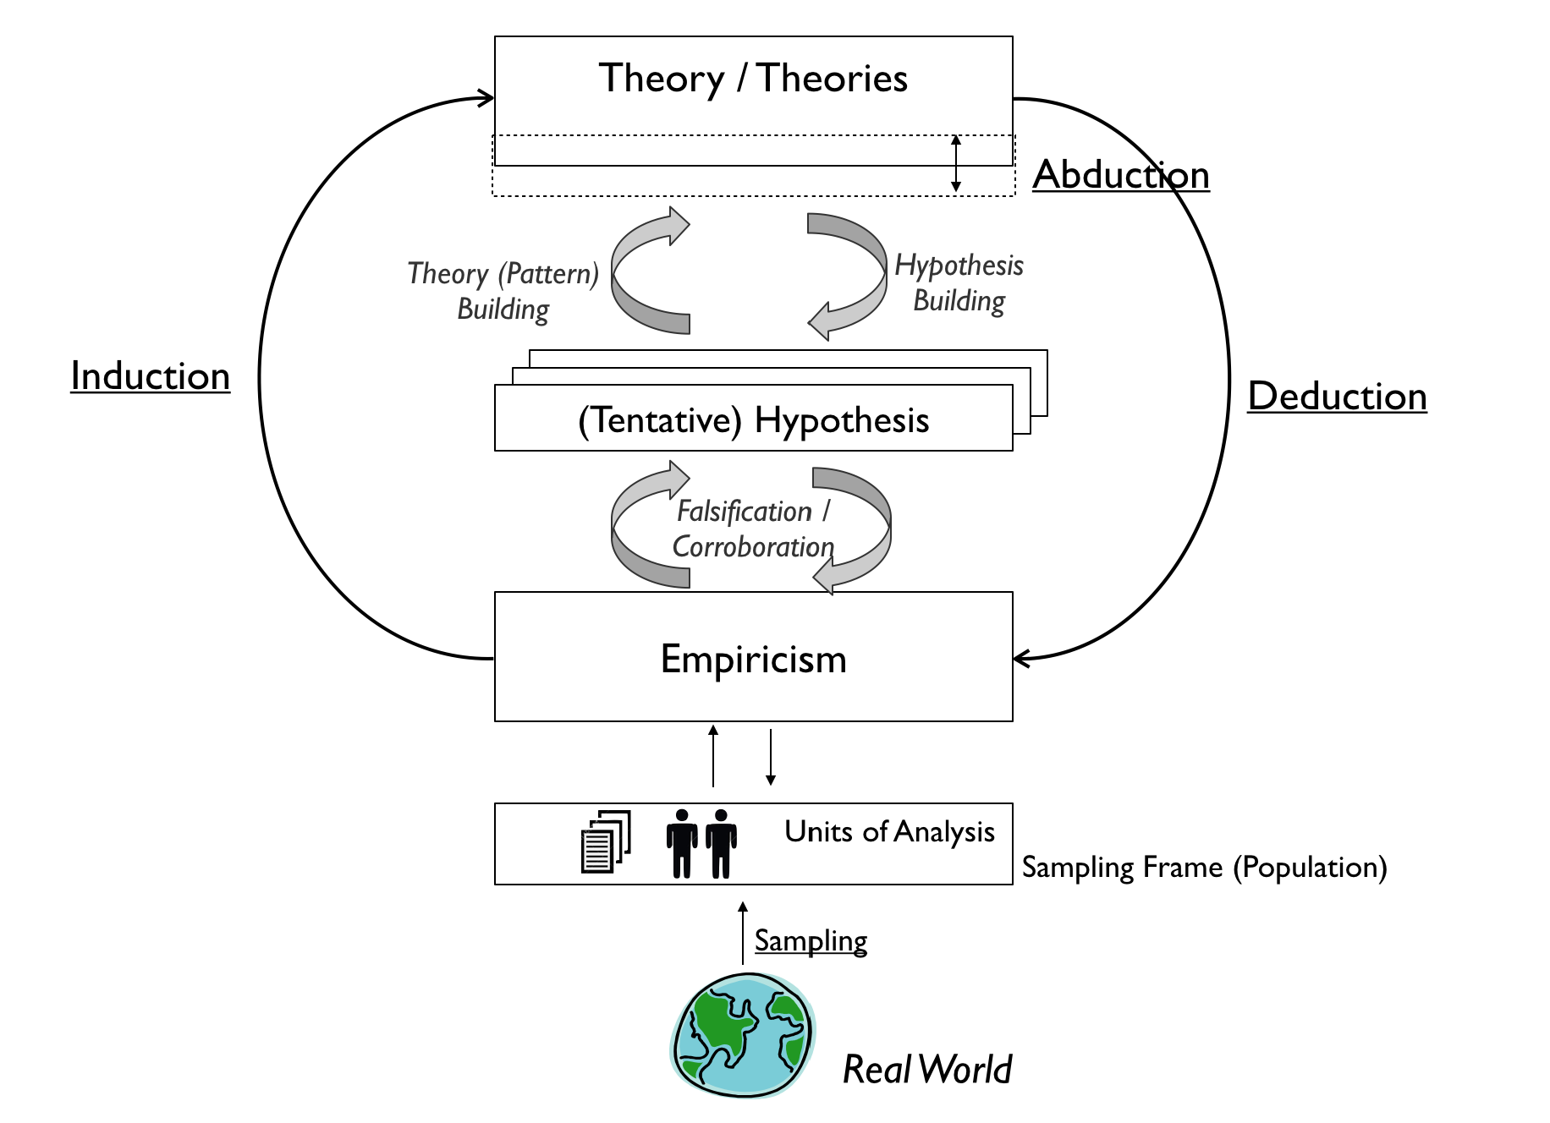
Scope
Knowledge growth through sensory experiences.

Slide 40
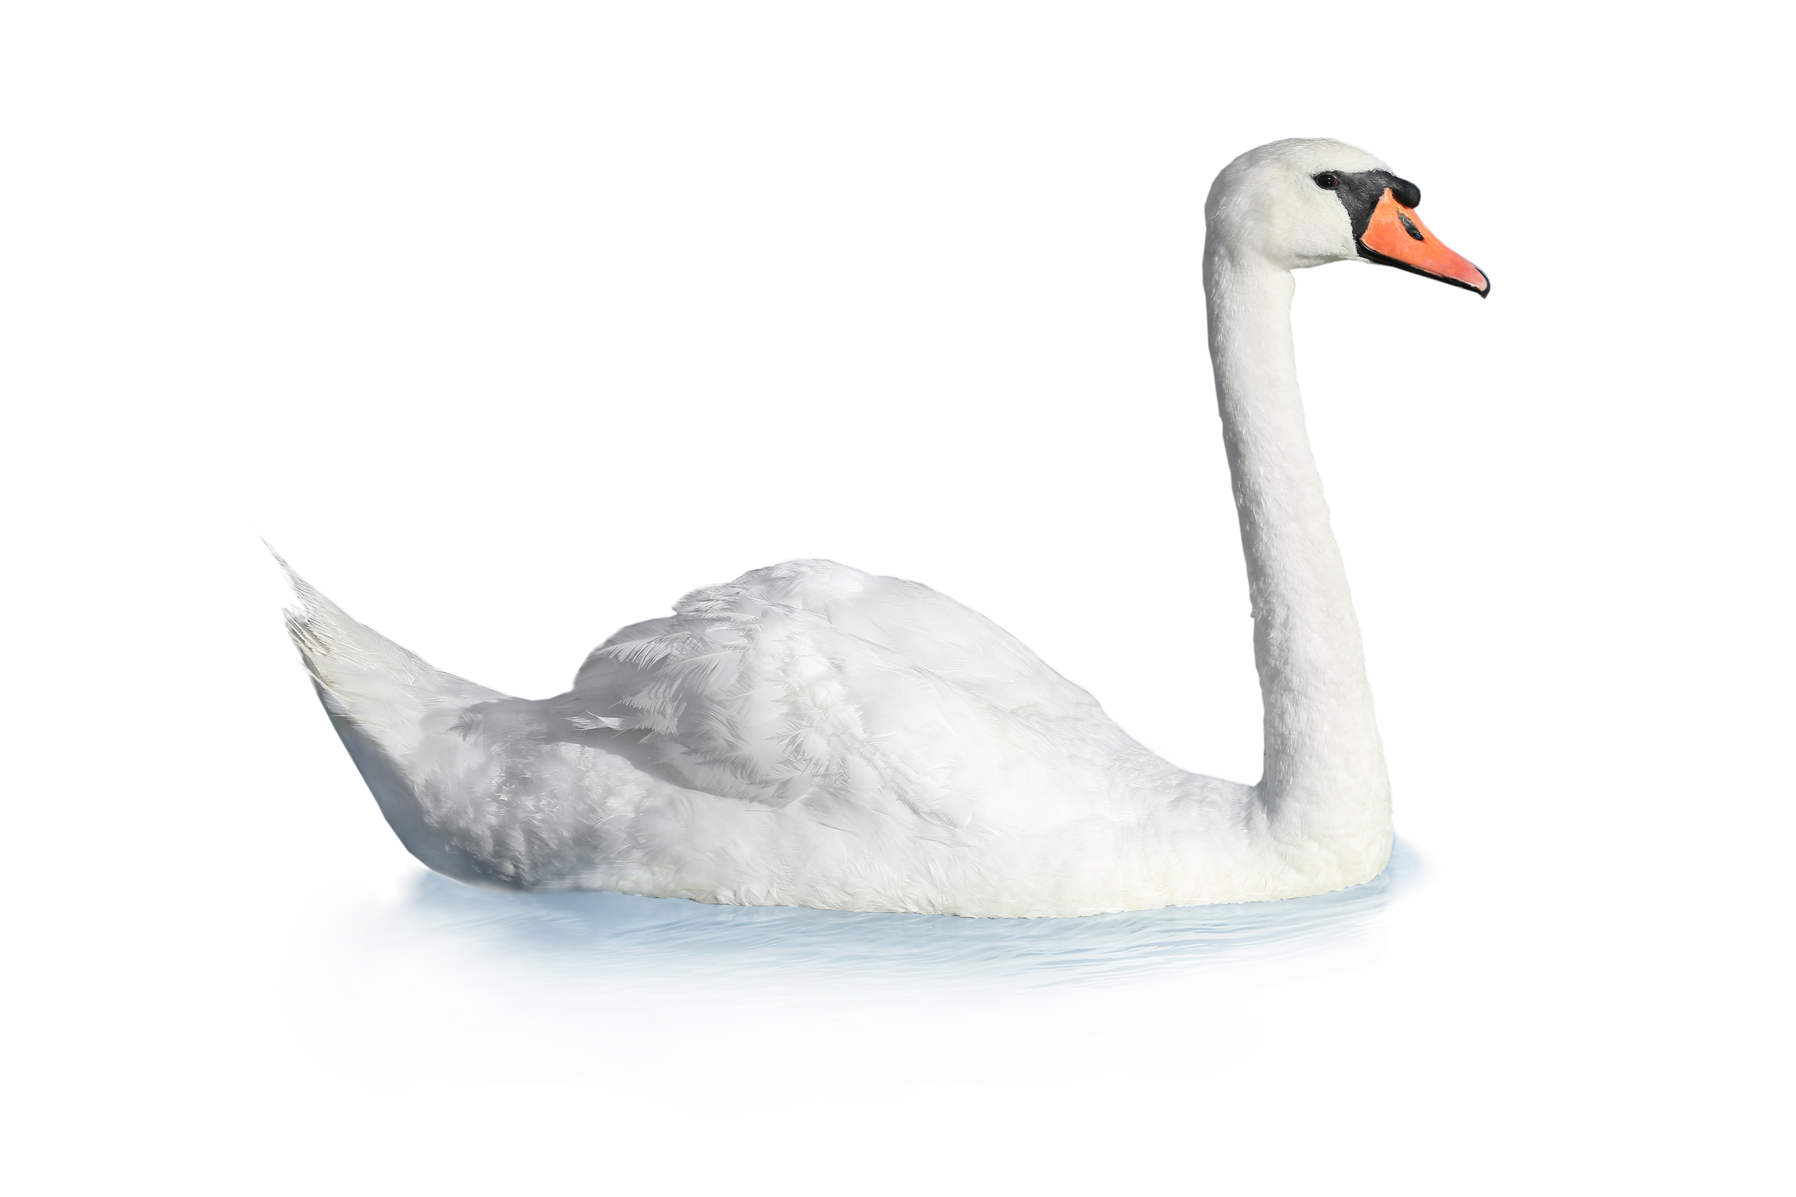
Example
Theory: “All Swans are white”
This statements (to be true) requires:
Knowledge about whole universe of swans (which exist, which have existed, and which will exist)
Objective interpretation of real world references

Slide 41
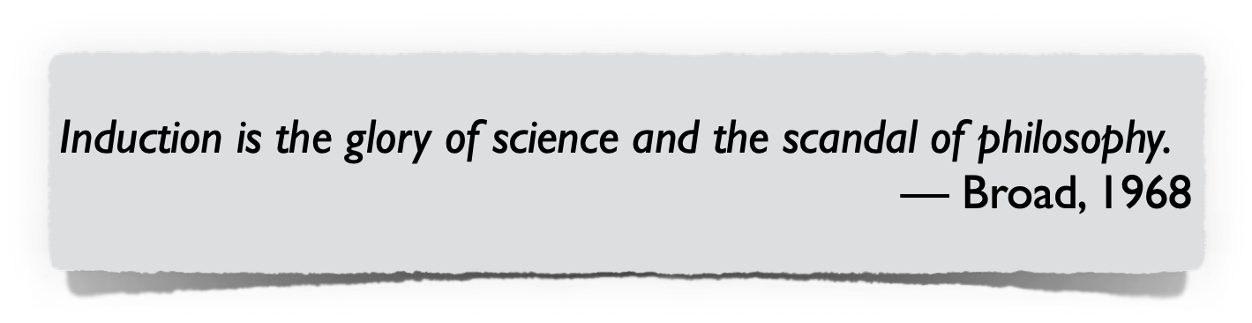
Limitations
Insufficient knowledge about the universe
Inductive inference consists of generalisation from observations made in some finite sample to broader population of instances (enumerative induction)
Finite set of observations is logically compatible with multitude of generalisations
Subjectivity in sensory experiences
Theories built upon underlying cognitive schemas and existing mental models
No amount of observations can (sufficiently) justify a universal belief
The problem with inductive reasoning is not per-se a problem of science (or scientific methods) so much as it is a problem of knowledge

Slide 42
Act 2
Era of Scientific Realism

Slide 43
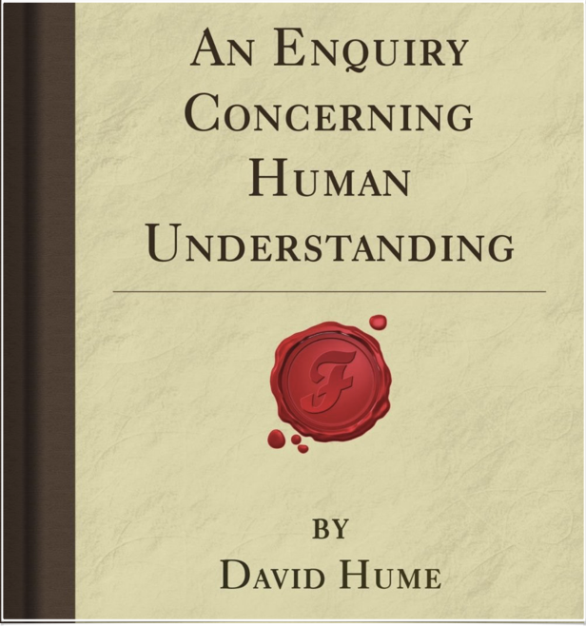
Principle problem of “induced” knowledge
David Hume (1711 — 1776) questions extent to which inductive reasoning can lead to knowledge
Inductive reasoning alone (and belief in causality), cannot be justified rationally
Relation to (predictive) theory building
Beliefs about future based on
experiences about the past and
assumption that the future will resemble the past
However, thousands of observations of event A coinciding with event B do not allow to logically infer that all A events coincide with B events
Example: It is logically possible that the sun won’t rise tomorrow
We don’t know that the sun will rise tomorrow, yet it is reasonable to believe (to a certain extent) it will rise

Slide 44
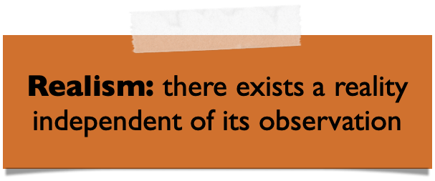
Scope
Scientific theories are (probably) approximately true when they achieve a certain level of success in prediction and experimental testing.
Based on: Staley,, K. An Introduction to the Philosophy of Science, 2014.

Slide 45

Related: Bayesianism
Traced back to Rev. Thomas Bayes 1701 – 1761 (essays published posthumously by Richard Price, then popularised by Pierre-Simon Laplace as today’s Bayesian probability)
Basis for theory of rational belief (on mathematical framework of probability theory)
Doctrine of chances (briefly)
Method of calculating the probability of all conclusions founded [so far] via induction
Probabilities represent current state of belief (“knowledge”) in light of currently available evidence
We “know” with certain confidence, i.e. strength of belief

Slide 46
Act 3
Era of Critical Rationalism

Slide 47
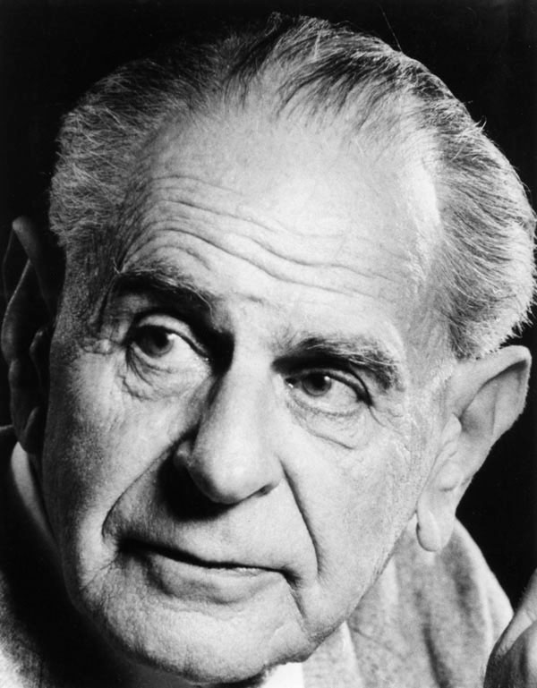
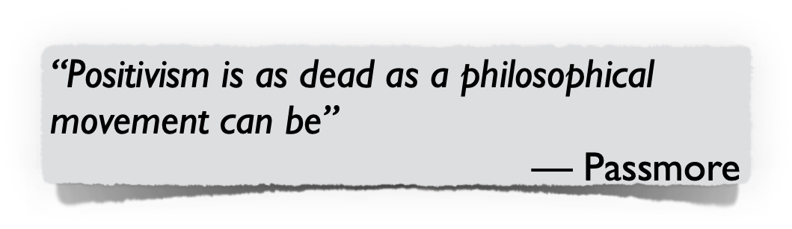
Origin and principles
Traced back to Sir Karl Popper (1902 - 1994).
Popper sees problems in induction as so sever that he rejects it completely
Response to logical positivism, i.e. verification by experience, as (initially) propagated by Vienna Circle (scientists meeting annually at the University of Vienna… and also at Café Central, starting 1907)
Falsification as demarcation criterion
From supporting theory via corroboration to criticising and refuting / rejecting it
Only falsifiable theories are scientific

Slide 48
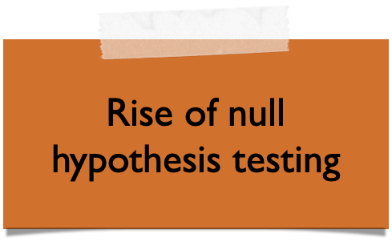
Scope
Knowledge growth through falsification.

Slide 49
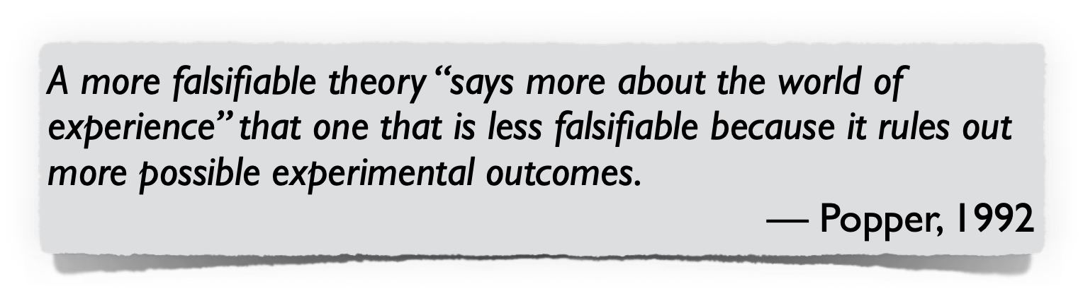
Principles for building and accepting theories
Falsifiability centres not on what a hypothesis says will happen, but on what it forbids, i.e. on experimental results that should not be produced
Always prefer those theories that are the most falsifiable ones (to have survived testing so far)
Theories are never solid, but they can be sufficiently robust to be commonly accepted after standing strong and repetitive attempts for falsification
Robustness of theories not by support / corroboration (free of inductive valences), but by extent to which it has survived falsifications

Slide 50
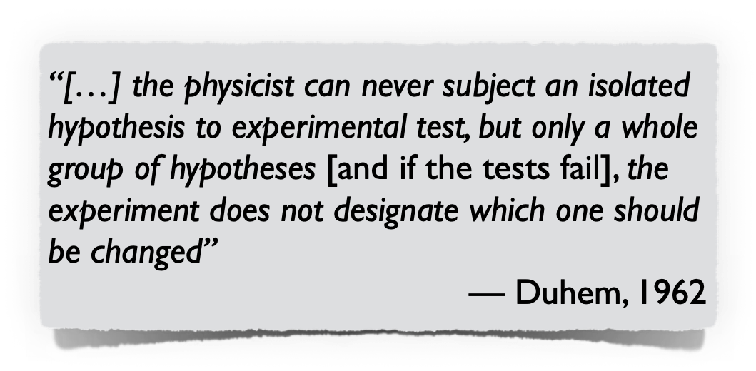
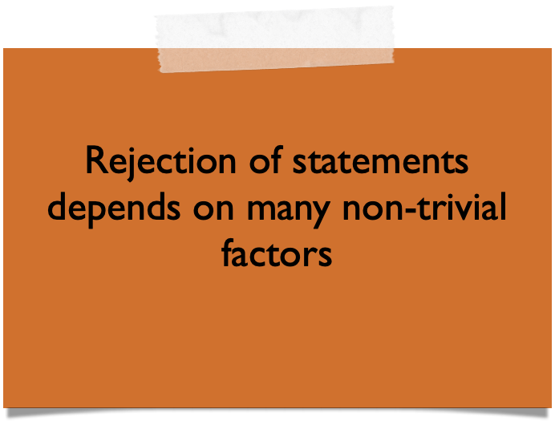
Limitations of critical rationalism
If a theory cannot be refuted, it may be also because:
One or more hypotheses are inadequate (if so, which one?)
“Underdetermination” problem
insufficient data
insufficient knowledge about causal relationships
Particularities of the context and conditions
Observations are incorrect
wrong or even not yet existing measurement
“wrong” interpretation
Often impossible to tell apart.

Slide 51
Act 4
Era of (pragmatic) Constructivism

Slide 52

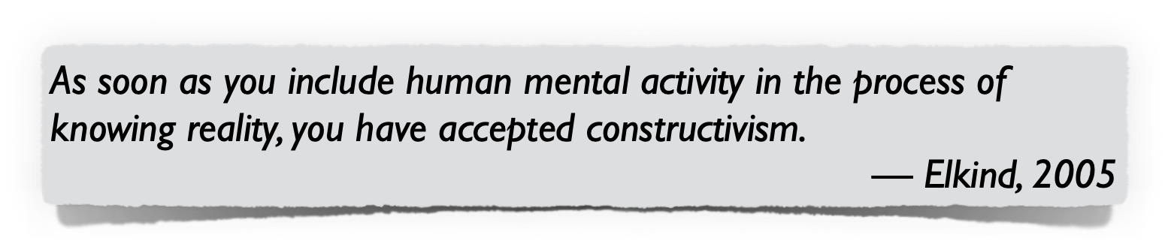

Pragmatism and Constructivism
Pragmatism is the recognition that there are many different ways of interpreting the world and undertaking research, that no single point of view can ever give the entire picture.
Constructivism is the recognition that reality is a product of human intelligence interacting with experience in the real world.

Slide 53
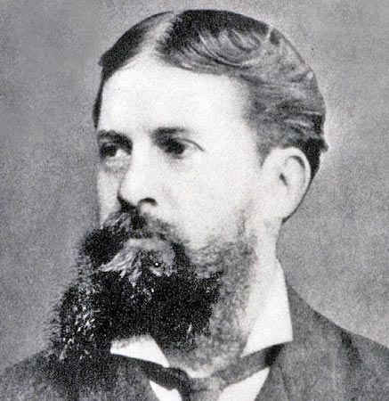
Origin and principles
Pragmatism initially coined by logician Charles Sanders Peirce (1839 – 1914)
Constructivism initially coined by psychologist Jean Piaget (1896 – 1980)
Maxims
Pragmatism: Method appropriateness judged by extent to which it answers inquiry question at hand
Value of methods (and theories) depends also on practical usefulness to solve a problem (W. James)
Constructivism: Accept that theories, background, knowledge and values of the researcher influence interpretation of physical reality
Scientific working is also a creative task
“Truth” depends (also) on acceptance by those who interpret reality
Pierce
Piaget

Slide 54
Scope
Knowledge growth comes in an iterative, step-wise manner* where researchers also may (or must) leave the realms of logic and apply creative reasoning.
1
3
2
Approach as introduced by Peirce
Identify hypothesis via abduction
Deduce consequences
Induce further facts to support hypothesis (otherwise return to 1.)

Slide 55


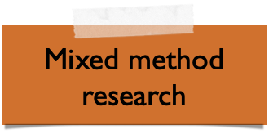
From Rationalism to Pragmatism
 | Rationalism | Constructivism | Pragmatism
What is the relationship between researcher and subject/object? | Researcher independent from what is being researched | Subjects interpret their “own” reality, researcher can become insider
What is the research strategy? | Deductive Hypothesis testing (corroboration / falsification) Context free Generalisations for predicting, explaining, and understanding | Inductive (Active) theory building Context bound Patterns and theories for understanding | Combination of inductive and deductive Context bound Patterns and theories for understanding Generalisations for predicting and explaining

Slide 56
What happened so far?
Local Problem-Solving View
Positivists (and realists) infer scientific knowledge - at least with a certain level of confidence - from direct observations (but what is this?)
Rationalists replace worse by better theories using falsification (but it is often unclear where problems lie; in the theory or in the observation?)
(Pragmatic) constructivist add a creative (and pragmatic) perspective for an iterative and local problem-solving
How does science progress in the long run?

Slide 57
Act 5
Era of Post-Positivism

Slide 58
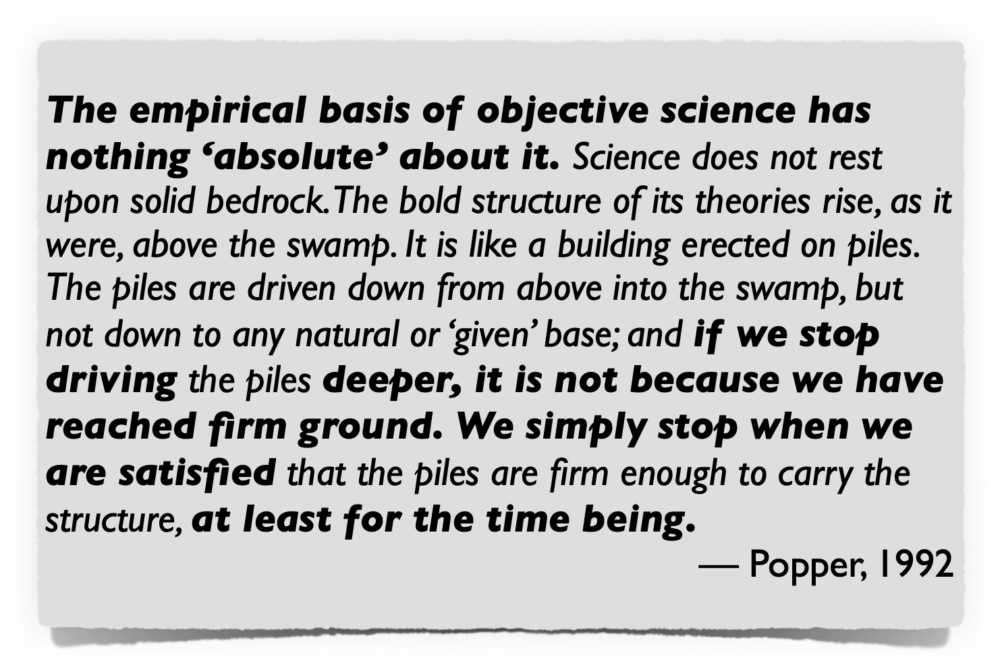

Slide 59
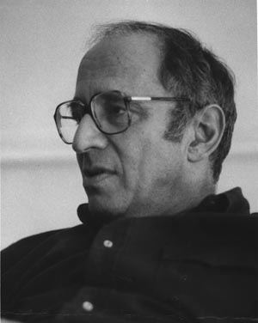
Origin and principles
Initially coined by Thomas Kuhn (1922-1996)
Scientific progress doesn’t follow piecemeal falsification / corroboration, but is revolutionary and influenced by sociological characteristics of scientific communities.
Scientists work within paradigms (and are uncritical towards their paradigm)
Maxim of paradigms
Paradigm is set of accepted fundamental laws, assumptions, standard ways of working (instrumentation and techniques)
Normal scientific activity is a puzzle-solving activity. Failures are failures of scientists, not the paradigm; puzzles that resist solution are usually anomalies rather than falsifications.
Progress via “revolutionary paradigm shift”

Slide 60
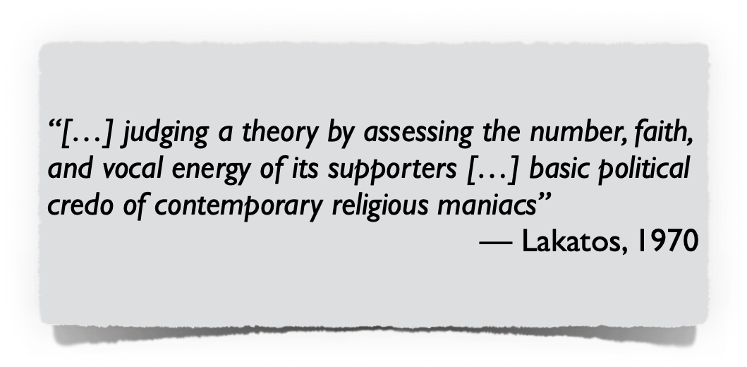
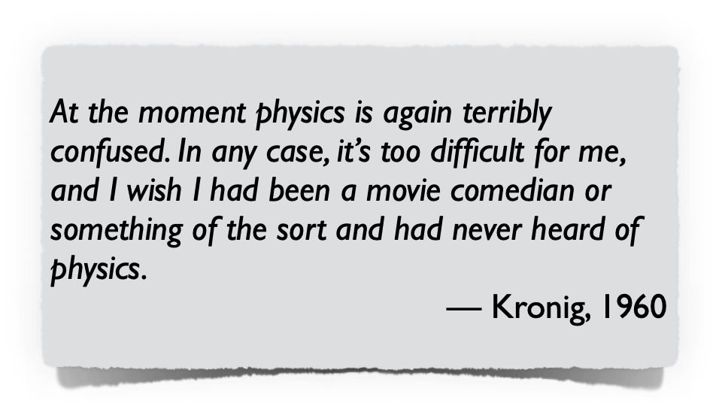
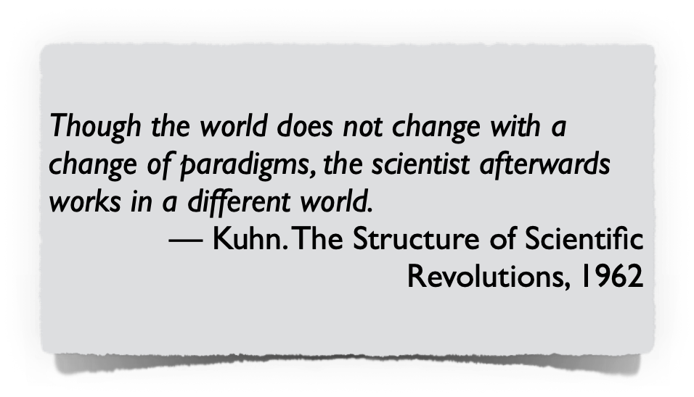
Scientific progress via “paradigm shifts”
Scientists work in communities within certain (incommensurable) paradigms
If no progress can be observed, it is an indicator for a crisis
A change of paradigm (“paradigm shift”) by acceptance of the community
Acceptance first, arguments later
Examples
Copernican revolution
Development of quantum mechanics
Agile methods?
Limitation
No notion of when a paradigm is „better“ than another

Slide 61
Research programmes
Coined by Imre Lakatos (born as “Lipschitz”)(1922-1974)
Kuhn’s revolutionary science had no notion of when a paradigm is „better“ than another, i.e. often not clear which hypothesis in a structure of hypotheses (i.e. theory) problematic
Structure via research programmes
Hard core: Non-falsifiable
Protective belt: falsifiable
Progress by modifying protective belt in testable way: Progressive research over degenerating research
Degenerative research: explaining what is already known
Progressive research: based on ability to predict novel facts

Slide 62
Scope
Knowledge growth not by following the (piece-wise) falsificationist or inductionist approaches, but through (in parts competing) programmes.
?

Slide 63
Limitations
No applicability to local problem-solving
Paradigm / programme debates not about (relative) problem-solving ability, but about which paradigm should in future guide research on problems (such a decision made based on faith)
No support for “quick wins” as (e.g.) in falsification as novelty can only be seen after a long period of (competing) programmes and continuous work within those programmes
(Still helps understanding social mechanisms involved)
Advancing knowledge is a paradigm/programme debate
Relies on acceptances by the communities based of belief to which extent theories can solve existing and future problems (science comes along a social and sometimes political process)
Progress based on acceptance by protagonists in communities

Slide 64
Act 6
Era of Epistemological Anarchy

Slide 65
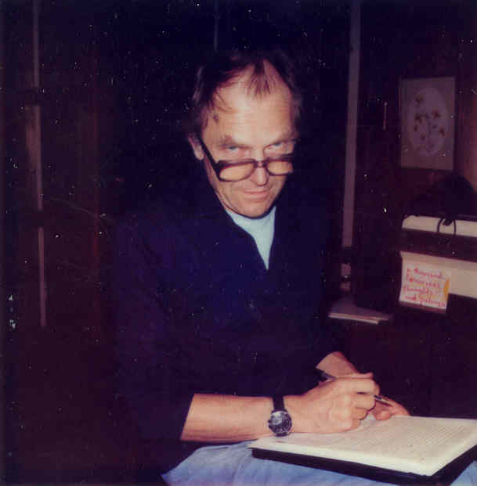
Origin and principles
Coined by Paul K. Feyerabend (1924-1994)
Did not express own conviction, but provoked communities to question theirs
Maxim of “Anything Goes”
Reject idea that there can be a universal notion of science (at least without ending up in total relativism)
Reject any attempt to constrain science by acceptance as it
inhibits free development of individual scientist
blocks growth of scientific knowledge
Chose whatever others might think is „progress“ and play the devil’s advocate

Slide 66

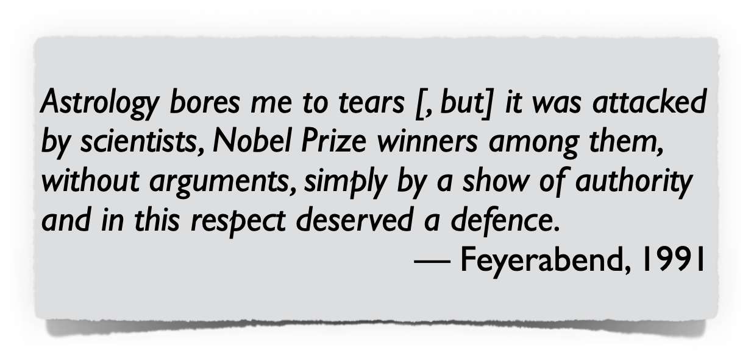

Paul Feyerabend: The (polemic) Devil’s Advocate
Paul Feyerabend, also known as the
Defender of Creationism
Defender of Astrology
Devil’s advocate

Slide 67
Scope
Knowledge growth by introducing new theories that challenge the established facts of any given time (“anything goes”).

Slide 68
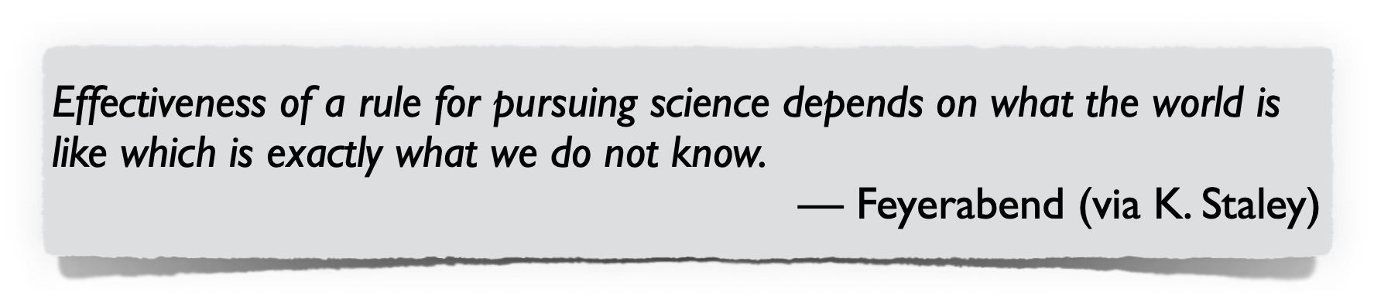
Principle: Reject authorities and challenge what we accept as “factually known”
No such thing as universal way of scientific working
Any rule used as “universal guide” to scientific working might, under some circumstances, prevent scientists from contributing to the progress of science
“Keep our options open”
No such thing as (universally acceptable) truth
Every explanation (no matter how absurd) is possible for an observation
No authority should be accepted
The highest duty of a scientist is to play the devil’s advocate

Slide 69
In which era do we live today?
Ideally, in all of them.

Slide 70



All views and contributions need to be considered
There is not the one “correct” epistemological approach, but many lessons we can learn from their historical evolution.
Further reading
Introduction into (one)
current debate
Overview of movements
and their historical context
(Many quotes based on this book)

Slide 71
Outline
Science (in a Nutshell)
Philosophy of Science - a Historical Perspective
Key Take Aways
From Philosophy of Science to Empirical Software Engineering
Empirical Software Engineering Processes
Current Challenges in Empirical Software Engineering

Slide 72
What are your take-away(s)?

Slide 73
Beware the basic principles of scientific progress
No such thing as absolute and / or universal truth (truth is always relative)
The value of scientific theories always depends on their
falsifiability,
ability to stand criticism by the (research) community,
robustness / our confidence (e.g. degree of corroboration),
contribution to the body of knowledge (relation to existing evidence), and
ability to solve a problem (e.g. practical problem).
Theory building is a long endeavour where
progress comes in an iterative, step-wise manner,
empirical inquiries need to consider many non-trivial factors,
we often need to rely on pragmatism and creativity, and where
we depend on acceptance by peers (research communities)
Scepticism and also openness are major drivers for scientific progress
Image Source: Monty Python

Slide 74
Adopt fundamental credos of scientific working
Be sceptical and open at the same time:
no statement imposed by authorities shall be immune to criticism
be open to existing evidence and arguments/explanations by others
Be always aware of
strengths & limitations of single research methods
strength of belief in observations (and conclusions drawn)
validity and scope of observations and related theories
relation to existing body of knowledge / existing evidence
Appreciate the value of
all research processes and methods
null results (one’s failure can be another one’s success)
replication studies (progress comes via repetitive steps)
Be an active part of something bigger (knowledge is built by communities)
Image Source: Monty Python

Slide 75
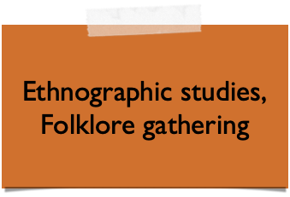
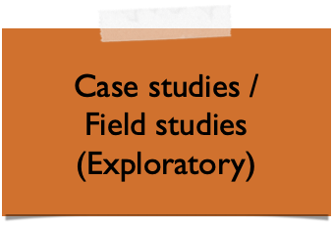
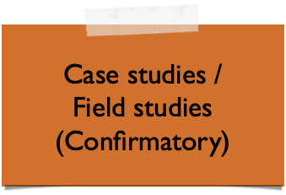
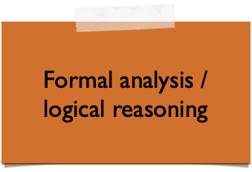
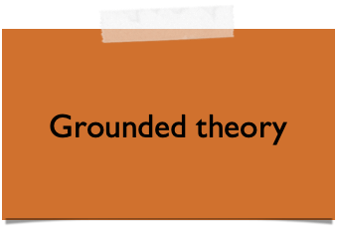
Understand the research methods: their purposes, strengths, limitations, and places in a bigger picture
Theory / Theories
Abduction
Theory (Pattern) Building
Hypothesis Building
Induction
Deduction
(Tentative) Hypothesis
Falsification / Corroboration
Empiricism
Units of Analysis
Sampling Frame (Population)
Sampling
Real World

Slide 76
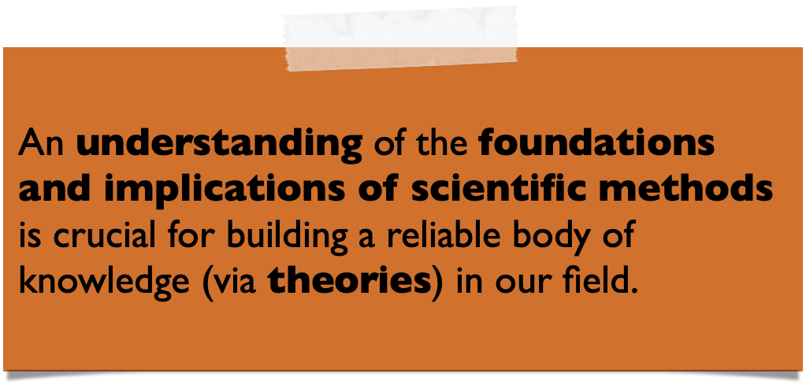


And yet, too often we see this
Research Question: Which car has the best driving performance?
H_0: There is no difference.
20 people without a driving licence participated. We taught them to drive in a lecture of 2 hours.
Results: The BMW is significantly better than the Daimler. ( p<0.01)
Adapted from: Dag I.K. Sjøberg (University of Oslo) Keynote at the International Conference on Product-Focused SW Process Improvement 2016, Trondheim, Norway.
Image Sources: Company websites

Slide 77
Outline
Science (in a Nutshell)
Philosophy of Science - a Historical Perspective
Key Take Aways
From Philosophy of Science to Empirical Software Engineering
Empirical Software Engineering Processes
Current Challenges in Empirical Software Engineering

Slide 78
Software Engineering research
Software engineering is development (not production), inherently complex, and human-centric
(Empirical) research methods allow us to
Reason about the discipline and (e.g. social) phenomena involved
Recognise and understand limits and effects of artefacts (technologies, techniques, processes, models, etc.) in their contexts
Exemplary questions
There exist over 200 documented requirements engineering approaches — Which one(s) work in my context? — To which extent? Under which conditions?
There is a new method for requirements elicitation — What are the strengths and limitations?
Building a reliable body of knowledge (theory building and evaluation) is key for progress in our field.

Slide 79
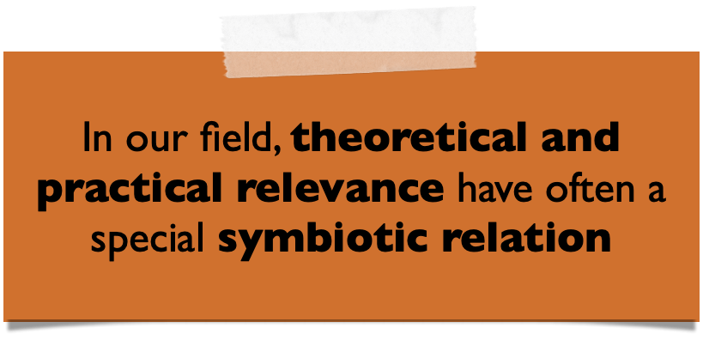
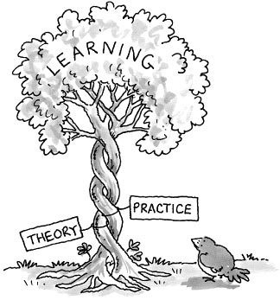
Empirical Software Engineering
The ultimate goal of empirical Software Engineering processes is theory building and evaluation to strengthen and advance our body of knowledge.
Practitioners “versus” Researchers
Researchers usually concerned with understanding the nature of artefacts and their relationship in the context
What is the effect?
Why is it so?
Practitioners usually concerned with improving their engineering tasks and outcomes, using available knowledge
What is the problem?
What is the best solution?

Slide 80

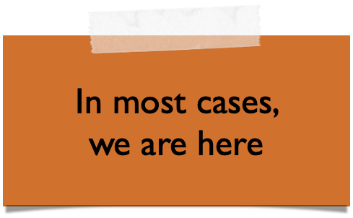
Current state of evidence in Software Engineering
Available studies too often
have severe (methodological) flaws
don’t report negative results
strengthen confidence on own hopes (and don’t report on anything around it)
discuss little (if at all) relation to existing theories
Strong evidence
+
Evidence
In favour / corroboration
Circumstantial evidence
Third-party claim
First or second party claim
First or second party claim
Third-party claim
Circumstantial evidence
Against / refutation
Evidence
-
Strong evidence
Source [for levels of evidence]: Wohlin. An Evidence Profile for Software Engineering Research and Practice, 2013.

Slide 81
Current state of evidence in Software Engineering
The current state of empirical evidence in Software Engineering is still weak.
We still lack robust scientific theories (let alone holistic ones)
Symptom: Many movements based on conventional wisdom, e.g.:
#noestimates (look it up on Twitter ;-)
goal-oriented requirements engineering (to be taken with a grain of salt)
Software engineering is, in fact, dominated by many “Leprechauns”

Slide 82
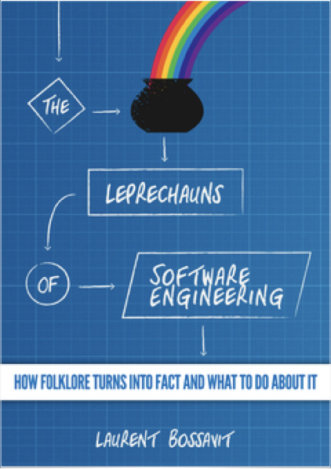
Leprechauns of Software Engineering
Folklore turned into “facts”
Many reasons for their existence
Emerged from times where claims by authorities where treated as facts
Lack of empirical awareness
Authors do not cite properly
Citing claims of (over-)conclusions as facts
Citing without reading properly (laziness or no access because work is paywalled)
Citing only one side of an argument
…

Slide 83
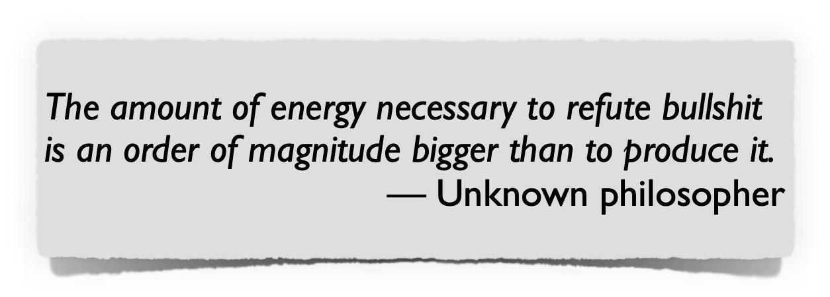


Why not simply debunk (i.e. falsify) folklore?
It is difficult and very time-consuming
To many, it’s not interesting / relevant
Often not appreciated by peers (“Novelty?”)
Strong evidence
+
Evidence
In favour / corroboration
Circumstantial evidence
Third-party claim
First or second party claim
First or second party claim
Third-party claim
Circumstantial evidence
Against / refutation
Evidence
-
Strong evidence
Source [for levels of evidence]: Wohlin. An Evidence Profile for Software Engineering Research and Practice, 2013.

Slide 84
Consequences
Limited problem-driven research
Based (often) on false claims/beliefs
Little practical/theoretical relevance
Inefficient practice
Lack of sufficient knowledge
Lack of efficient methods and tools
Image Source (l) http://andrewboynton.com/wp-content/uploads/2011/03/IvoryTower.jpg
Image Source (r) http://www.tagesspiegel.de/images/aktueller-stand-am-hauptstadtflughafen/13424442/2-format6001.jpg

Slide 85

Theory building and theory evaluation is crucial in SE
… otherwise, we are not the experimental counterpart to theoretical computer science, but the homeopathic one.

Slide 86
Outline
Science (in a Nutshell)
Philosophy of Science - a Historical Perspective
Key Take Aways
From Philosophy of Science to Empirical Software Engineering
Empirical Software Engineering Processes
Current Challenges in Empirical Software Engineering

Slide 87
The ultimate goal of empirical Software Engineering processes is theory building and evaluation to strengthen and advance our body of knowledge.
But how?

Slide 88
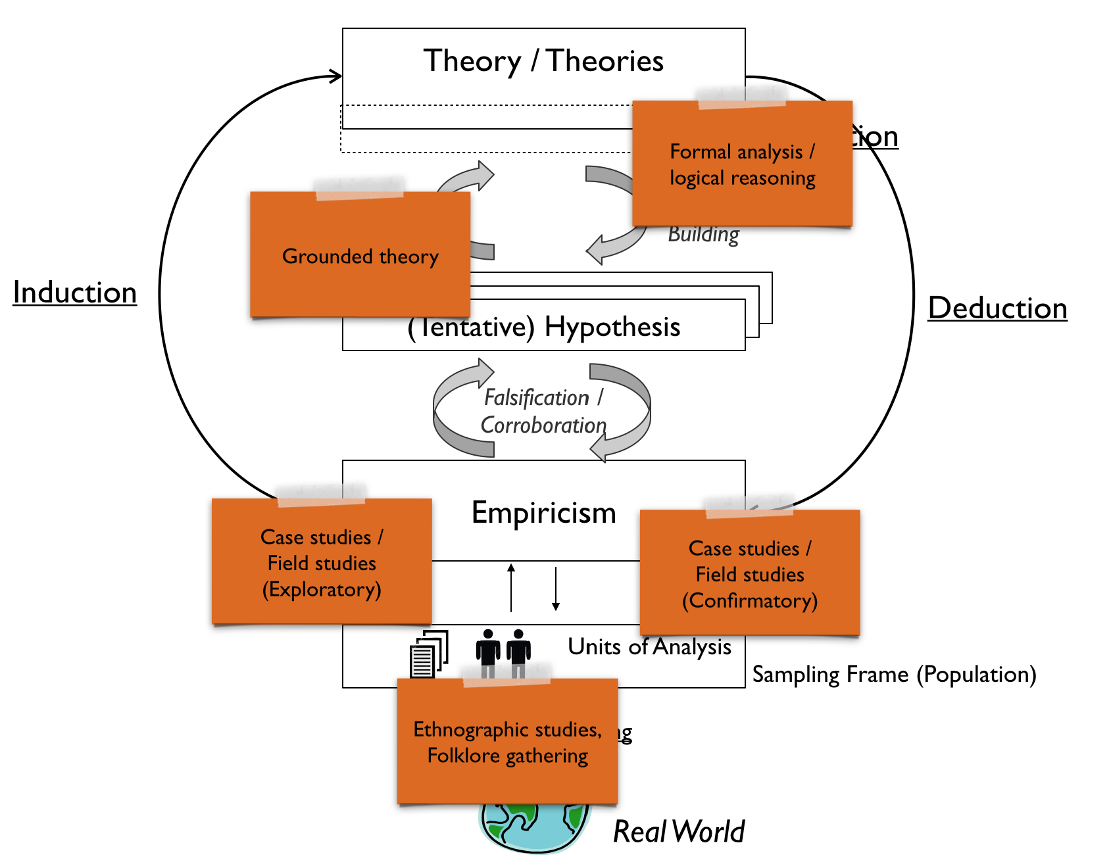
(Reminder)
Progress comes in an iterative, step-wise manner
Each step has a specific objective and purpose.

Slide 89

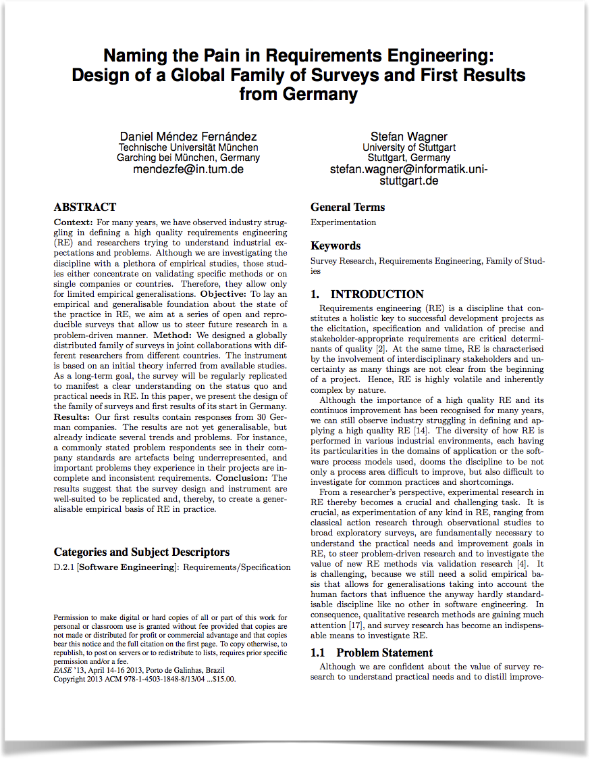
Research objective / Purpose
Exploratory survey to better understand current state of practice and related problems in Requirements Engineering
Method
(Online) survey research

Slide 90
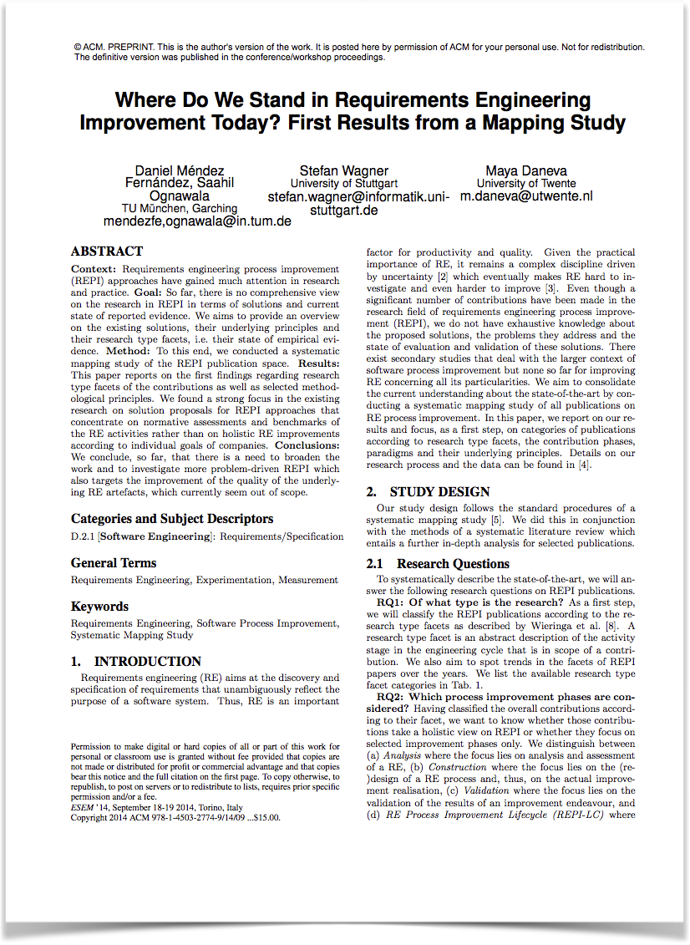
Research objective / Purpose
Exploratory literature study to understand current state of reported evidence in Requirements Engineering (process) improvement and potential gaps
Method
Systematic mapping study

Slide 91
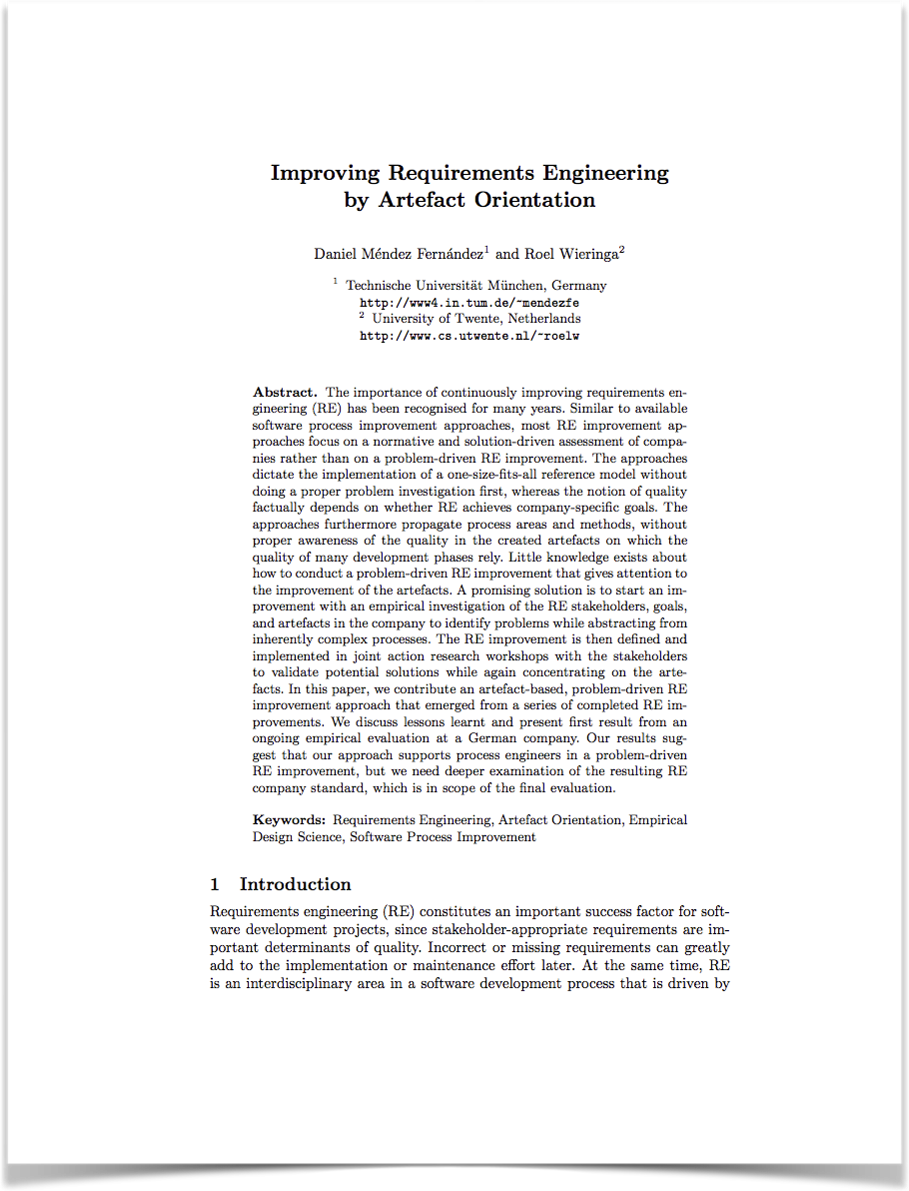
Research objective / Purpose
Design of an RE improvement approach by synthesising existing concepts
Method
(Design) theory building

Slide 92

Research objective / Purpose
Comparative case study to understand benefits and limitations when improving RE following a specific approach
Method
Case study research with canonical action research
Independent replication

Slide 93






Different objectives require different methods

Slide 94

There is no universal silver-bullet*
* Reminder: No universal way of scientific working.

Slide 95
Empirical processes: an abstract view
Planning and Definition
Identify and outline problem (area)
Determine research objectives
Method and Strategy Selection
Select type of study and method(s)
Identify necessary environment (including units of analysis)
Design and (Method) Execution
Design and validate study protocol (and validity procedures)
Employ research method following respective (detailed) processes
Conclusion Drawing
Analyse data
Reflect on potential threats to validity
Packaging and Reporting
Package (and ideally disclose) data
Report on results (in tune with audience)

Slide 96






Empirical processes: an abstract view
Planning and Definition
Which method(s) do we need to employ?
Method and Strategy Selection
Scope of detailed empirical methods
Design and (Method) Execution
Conclusion Drawing
Packaging and Reporting

Slide 97
Planning and definition
Planning and Definition
At the end of the planning phase, we need to know:
Why should the empirical study be conducted (purpose and goal)?
What will be investigated?
Steps to get there:
Identify (potential) problems
Select problem in scope of study
Formulate research goal / questions
Method and Strategy Selection
Design and (Method) Execution
Conclusion Drawing
Packaging and Reporting

Slide 98

Problem identification
What is the goal?
Identify open (theoretical and / or practical) problems
What could be good starting points?
Existing (i.e. reported) hypotheses or theories
Claims or assumptions about, e.g., a technologies effectiveness
Results that contradict common hypotheses or theories
Analyse the state of the art
(Systematic) literature reviews / mapping studies
(complementarily) Analyse the state of the practice
Document analysis (projects, public repositories, etc.)
Interviews, surveys, and observations

Slide 99
Problem selection
Scientific criteria
How does its investigation contribute to research (theoretical relevance)?
To which extent can it be investigated empirically?
…
Practical criteria
To which extent is it a practical problem (practical relevance)?
To which extent does the problem depend on particularities of a practical context?
…
Ethical (and also pragmatic) criteria
Does the investigation imply (personal) benefits, disadvantages, risks, harms?
Is it necessary and possible to collect and keep data anonymous?
How could and should the results (and data) be published?
…

Slide 100
Type of research goals (and purposes of methodologies)
 | Explanatory | Exploratory | Descriptive | Improving
Scope | Seeking an explanation of a situation or a problem Mostly but not necessarily in the form of a causal relation-ship | Finding out what is happening, seeking new insights and generating ideas and hypotheses for new research Understanding events, decisions, processes, …, and their meaning in specific context based on subjects’ insight | Portraying a situation or phenomenon. Drawing accurate descriptions of events, decisions, processes,… , and the relations among them | Trying to improve a certain aspect of the studied phenomenon Prerequisites Baseline models (practice) Standards Oracles
Basis for… | … precise hypothesis and theories …prediction models | …new (tentative and vague) hypothesis (out of curiosity-driven research) | … precise hypothesis and theories | … under-standing the impact of artefacts
Based on: Runeson, P, Höst, M. Guidelines for conducting and reporting case study research in software engineering, 2009.

Slide 101

Research goal definition
Analyse __________________________________________ (units of analysis: process, product, people, …)
for the purpose of ________________________________ (purpose: understand, describe, explain, evaluate, change, …)
with respect to ___________________________________ (quality focus: cost, correctness, reliability, usability, ...)
from the point of view of __________________________ (stakeholder: user, customer, manager, developer, corporation,. ..)
in the context ____________________________________ (context: problem, people, resource, or process factors, ...)
Based on: Basili, V., Caldiera1, G., Rombach, D.The Goal Question Metric Approach, 1994.

Slide 102

Research goal definition
Analyse a problem-driven requirements engineering improvement approach (units of analysis: process, product, people, …)
for the purpose of evaluation (purpose: understand, describe, explain, evaluate, change, …)
with respect to usability (inter alia) (quality focus: cost, correctness, reliability, usability, ...)
from the point of view of (process) engineers (stakeholder: user, customer, manager, developer, corporation,. ..)
in the context custom software development projects (context: problem, people, resource, or process factors, ...)

Slide 103
From research goals to research questions
Non-causal research questions
What is X? What does X mean?
What are the differences between X1 and X2?
How does X work? Why / why not?
How do you select/adopt/use/estimate/…. X?
Why does a subject support/select/adopt/use/…. X?
Casual research question
Does X cause Y?
Does X1 cause more of Y than X2 causes of Y?

Slide 104
From research goals to research questions
Non-causal research questions
RQ 1 How well are process engineers supported in their RE improvement tasks?
RQ 2 How well are project participants supported by the resulting RE reference model?

Slide 105
Method and strategy selection
Planning and Definition
Method and Strategy Selection
At the end of the method selection phase, we need to know:
What type of study do we need to conduct?
Which empirical method(s) do we need?
What is the necessary environment?
Steps to get there:
Identify method(s) and environment based on goals and purpose
Reflect on further important decision criteria (often coming with a trade-off)
Design and (Method) Execution
Conclusion Drawing
Packaging and Reporting

Slide 106

What is the nature of the study? (Inductive? Deductive? Both?)
 | Explanatory | Exploratory | Descriptive | Improving
Scope | Seeking an explanation of a situation or a problem Mostly but not necessarily in the form of a causal relationship | Finding out what is happening, seeking new insights and generating ideas and hypotheses for new research | Portraying a situation or phenomenon. | Trying to improve a certain aspect of the studied phenomenon
Purpose of methodology
*
* To be seen as indicators only

Slide 107

What is the relation to the existing body of knowledge?
Purpose of theory
 | Analytical | Predictive | Explanatory | Explanatory & Predictive
Scope | Descriptions and con-ceptualisations, including taxonomies, classifications, and ontologies - What is? | Prediction of what will happen in the future - What will happen? | Identification of phenomena by identifying causes, mechanisms or reasons - Why is? | Prediction of what will happen in the future and explanation - What will happen and why?
?
Building a new theory?
“Testing”/Modifying existing theory?
 | Explanatory | Exploratory | Descriptive | Improving
Scope | Seeking an explanation of a situation or a problem Mostly but not necessarily in the form of a causal relationship | Finding out what is happening, seeking new insights and generating ideas and hypotheses for new research | Portraying a situation or phenomenon. | Trying to improve a certain aspect of the studied phenomenon
Purpose of methodology

Slide 108


What is the nature of the question we ask? (What versus Why)
Why?
What?
 | Explanatory | Exploratory | Descriptive | Improving
Scope | Seeking an explanation of a situation or a problem Mostly but not necessarily in the form of a causal relationship | Finding out what is happening, seeking new insights and generating ideas and hypotheses for new research | Portraying a situation or phenomenon. | Trying to improve a certain aspect of the studied phenomenon
(Non-exclusive, details in the method descriptions)
Case Study
Survey
Experiment

Slide 109








What is the nature of the environment?
What?
Why?
(Need for) reality
(Need for) control
Theoretical space
Environment made irrelevant
Artificial (controlled) environment
Realistic environment
Artificial
Reality

Slide 110









What is the population source?
Artificial
Reality
An (imperfect) universe of possibilities

Slide 111
What are the units of analysis?
Artefacts (e.g. specification documents, log files)
People (e.g. Java developers, process engineers) or
Groups of people (e.g. teams, companies)

Slide 112

Method and strategy selection: Summary of important decision criteria
What is the purpose of the study?
Exploratory? Descriptive? Explanatory? Improving?
What is the nature of the study?
Inductive? Deductive?
What is the relation to the existing body of knowledge?
Building a new theory? Testing existing theory?
What is the nature of the questions we ask?
What-questions? Why-questions?
What is the nature of the environment?
Controlled environments? Realistic environments?
What is the necessary sample?
Population source?
Units of analysis?
Criteria for selecting methods
Criteria for environment selection (and sampling)

Slide 113
Method and strategy selection: Summary of important decision criteria
What is the purpose of the study?
Improving
What is the nature of the study?
Deductive
What is the relation to the existing body of knowledge?
Testing existing (design) theory
What is the nature of the questions we ask?
Why-questions
What is the nature of the environment?
Realistic environment
What is the necessary sample?
Group of process engineers in a custom software development team

Slide 114
Is that all?
No (of course not).

Slide 115

Scientific working is influenced by various criteria
Purpose of the methodology
Degree of realism and control
Scope of the study (and validity)
Theoretical impact
Practical impact
Usefulness of emerging theories to researchers and practitioners
Access to data
Risk of failure
Time and cost
…

Slide 116
How do we achieve scientific progress?
In an iterative and step-wise manner.

Slide 117


The scope of interest is elaborated in multiple steps
Source: Sjøberg, D., Dybå, T., Anda, B., Hannay, J. Building Theories in Software Engineering, 2010.

Slide 118

Scope of validity
Realistic environment
Replications
Survey Research
Case Study Research
Field Study Research
Simulation
Scope of validity*
Controlled (lab) Experiment
Replications
Artificial environment
* Extremely simplified view to orient discussions, please don’t sue me.

Slide 119




Case studies and experiments complement each other in scaling up to practice
Focus of case studies
Similarity to population units
Street credibility
Realistic case
Scaling up to practice
Focus of (lab) experiments
Simple model
Lab credibility
Small sample
Large sample
Sample size
(Focus of field studies and replications)
Based on: Wieringa R. Empirical Research Methods for Technology Validation: Scaling Up to Practice, 2013.

Slide 120
Scaling up in a multi-study approach
1
2
Problem analysis
e.g. Systematic Mapping Study
2
Proposal new / adaptation existing technology
3
4
5
1
Replication
e.g. RE Improvement Approach
3
Validation of new technology in artificial setting
Replication
e.g. Controlled Experiment
4
Evaluation of new technology in realistic setting
e.g. Case Study
5
Large-scale evaluation
e.g. Field Study

Slide 121
Outline
Science (in a Nutshell)
Philosophy of Science - a Historical Perspective
Key Take Aways
From Philosophy of Science to Empirical Software Engineering
Empirical Software Engineering Processes
Current Challenges in Empirical Software Engineering

Slide 122
Background: ISERN (Community)
Foto taken at ISERN meeting 2016 in Ciudad Real, Spain

Slide 123








Background (cont.)
Goal
Agree, within the community, on top problems in empirical software engineering
Reason
Boost a common understanding of what we think is important
Identify opportunities to make relevant contribution
Focus resources and foster collaboration (on problem solving)
Disclaimer: Study carried out by Andreas Jedlitschka (IESE) and Natalia Juristo (UPM)

Slide 124

Top challenges as experienced by ISERN members (excerpt)
Collaboration with industry / reaching out
Contextualisation
Data collection (incl. automation) and data quality assurance
Generalisation of results and theory building
Families of studies and replications
(Unified) terminology
Sampling
Quality (assurance) of empirical studies
Synthesis and aggregation of results
(Standardised) reporting

Slide 125



Sampling: size (doesn’t) matter
Too often…
Sample size seems to be everything
Whereas…
Appropriateness of sample size depends on research methods employed, and
the actual population and units of analysis.
Source: Don’t ask…

Slide 126
Contextualisation
Too often…
Researchers do not contextualise properly (or report on it) because
it is difficult, or because
they are unaware of it.
Whereas…
The context determines the scope of validity
We have valuable taxonomies with context factors (e.g. in the field of SW process modelling), but they are often unknown or neglected
Variables actually reported
Variables you can report
Variables you should report

Slide 127

Relation to existing evidence
Too often…
Researchers do often not report on the relation to existing evidence
Whereas…
Scientific progress depends on exactly this
Image source: Huff, D. How to lie with statistics, 1954.

Slide 128

Conclusion drawing
Too often…
People mistake knowledge with statistical significance while over-interpreting their results
Whereas…
Progress is a step-wise procedure (while every step has its own value)
Image source: xkcd

Slide 129

Accurate reporting of results
Too often…
Results are not properly reported / disseminated to practice and / or academia
lack of details
lack of structure
Whereas…
Proper reporting is the foundation for reliability and reproducibility
We have standards for reporting study results, but they are often unknown or simply neglected
Image source: [Shameful paper that shall not be named]

Slide 130



(Data) Openness
Too often…
Researchers do not share their data, because they might be
afraid of doing so
not able to do so (NDAs)
unaware of the possibilities to do so
…
Whereas…
Openness is the foundation for
reliability and trustworthiness
reproducibility and replicability
We have repositories for sharing the data
Source: http://www.nature.com/news/announcement-reducing-our-irreproducibility-1.12852

Slide 131



How to deal with all these problems?
Education on scientific working including
research methods and practices - The What
their setting in a bigger picture - The Why
Rely on standards and contribute to standards
Take your message out (evangelise)
Thank you!
(and enjoy the rest of the course :-)
@mendezfe

